Slide 1
오후 Beautiful Soup

Slide 2
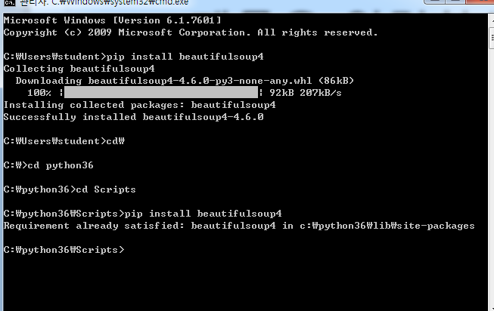
Cmd에서 뷰티플숩설치

Slide 3
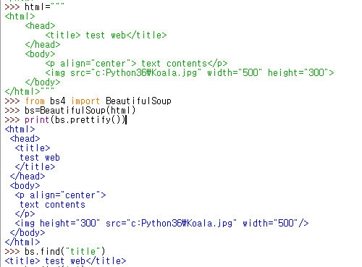
Beautiful Soup 사용하기
Notes:
>>> html="""
<html>
<head>
<title> test web</title>
</head>
<body>
<p align="center"> text contents</p>
<img src="c:python36\Koala.jpg" width="500" height="300">
</body>
</html>"""
>>> html="""
<html>
<head>
<title> test web</title>
</head>
<body>
<p align="center"> text contents</p>
<img src="c:Python36\Koala.jpg" width="500" height="300">
</body>
</html>"""
>>> from bs4 import BeautifulSoup
>>> bs=BeautifulSoup(html)
>>> print(bs.prettify())
bs.find("title")
<title> test web</title>

Slide 4
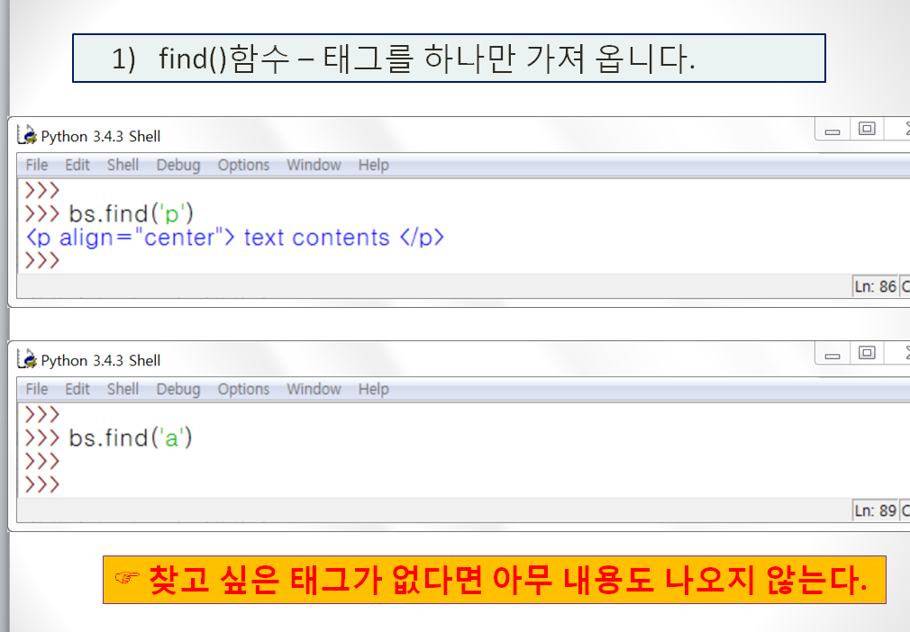
Find()-태그를 하나만 가져옴
>>> bs.find('p')
<p align="center"> text contents</p>
>>> bs.find('a')
Notes:
>>> bs.find('p')
<p align="center"> text contents</p>
>>> bs.find('a')

Slide 5
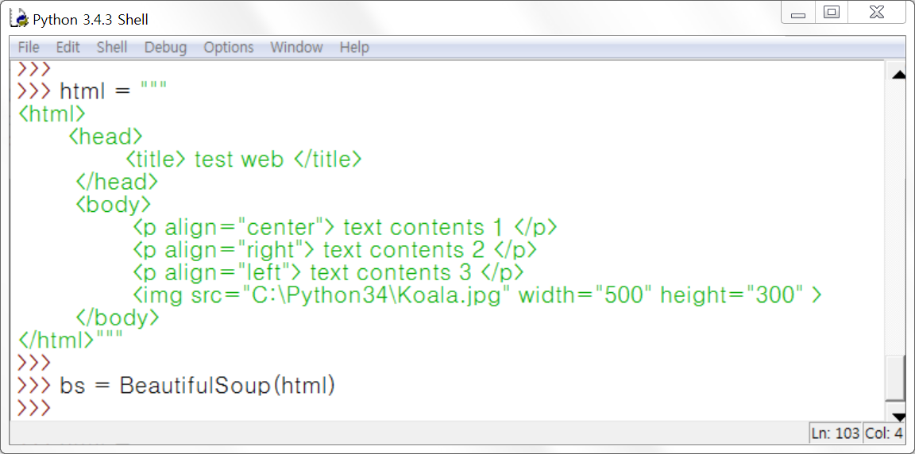
Html 코드 가운데 부분 수정하기
Notes:
>>> html="""
<html>
<head>
<title> test web</title>
</head>
<body>
<p align="center"> text contents1</p>
<p align="right"> text contents2</p>
<p align="left"> text contents3</p>
<img src="C:python36\Koala.jpg" width="500" height="300">
</body>
</html>"""
>>> bs=BeautifulSoup(html)

